Slide 1
SOFTWARE GROUP PROJECT
Prepared By:
JAY PATEL(18IT088)
DARSHAN PATEL(18IT079)
Project Guide: Harsh Patel

Slide 2

PROJECT TITLE
RADAR WITH ARDUINO

Slide 3
CONTENS
Introduction
Equipment
Circuit diagram
Acceptance criteria
Conclusion

Slide 4
INTRODUCTION
Project Goal : - Arduino is a single-board microcontroller to make using electronics in multidisciplinary projects more accessible.
Useful for security and protection and can reduce some accidents.
Use radio waves to determine the range , altitude and direction of objects.

Slide 5
EQUIPMENTS
HARDWARE :
1- Computer for writing the code.
2- Arduino UNO.
3- Ultra sonic sensor(HC –SR04).
4- Servo motor (Sg 90).
5- Buzzer
6- Connecting wires.

Slide 6
EQUIPMENTS
SOFTWARE:
ARDUINO GENUINO 1.8.9 used for setting up the code in the Arduino.

Slide 7
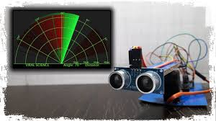
ACCEPTANCE CRITERIA
Simplicity in hardware part.
Our system is cheap and reflects radar requirements.

Slide 8
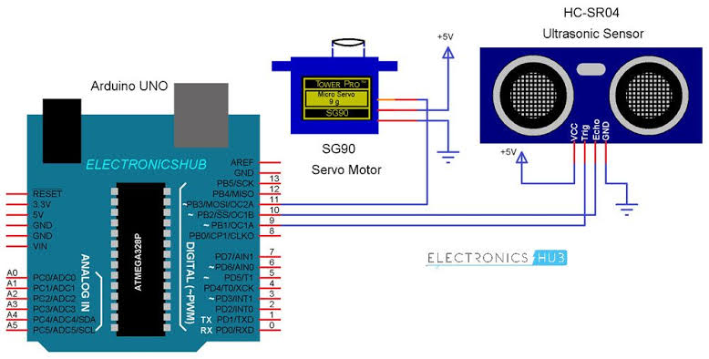
CIRCUIT DIAGRAM

Slide 9
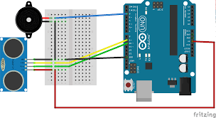
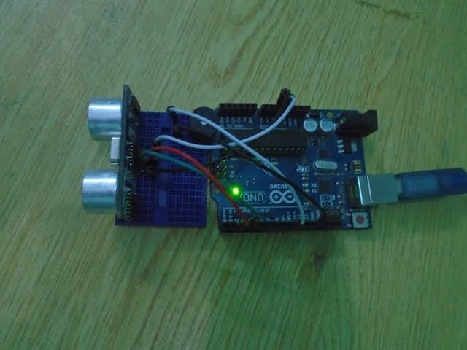

Slide 10
ADVANTAGES:
It is not affected by color or transparency. Basically, the Ultrasonic Sensors transmit the sound off of the object, hence the color and transparency have no effect on the radar reading.
Any dark environments have no effect on this Arduino radar sensor’s detection procedure. So, it can also use at night.
Easy to design and low price. The ultrasonic sensors are available at the market with very cheap price.

Slide 11
ADVANTAGES:
The Arduino Radar Sensor is easy to use. Also, it is completely safe during the operation to nearby objects, human or equipment.
This radar sensor is not affected by dust, rain, snow and many more.

Slide 12
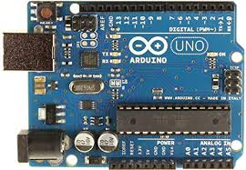
FEATURES OF THE ARDUINO UNO BOARD
It is an easy USB interface. This allows interface with USB as this is like a serial device.
It has more number of hardware features like timers, external and internal interrupts and multiple sleep modes.

Slide 13
14 digital pins and 6 analog pins. This sort of pins allows you to connect hardware to your Arduino board externally.
It has a 32 KB of flash memory for storing your code.
An on-board LED is attached to digital pin 13 to make fast the debugging of code and to make the debug process easy.

Slide 14
CONCLUSION
ARDUINO is the most important class of our system design.
Establishing the synchronization between sending and receiving data between the blocks is the most important issue.
As future work, use increasing in machinery and range of Arduino’s rang and better type of sensor we using and we give a one type of automatic power supply.

Slide 15
REFERENCES
https://www.instructables.com/id/Arduino-Distance-Detector-with-a- Buzzer-and-LEDs/
https://create.arduino.cc/projecthub/ammaratef45/detecting-obstacles- and-warning-arduino-and-ultrasonic-13e5ea
https://howtomechatronics.com/projects/arduino-radar-project/
https://howtomechatronics.com/projects/arduino-radar-project/
http://www.toptechboy.com/arduino/lesson-20-arduino-lcd-project-for- measuring-distance-with-ultrasonic-sensor/

Slide 16


DEVELOPER
DARSHAN PATEL
JAY PATEL

Slide 17
Thank You

